Slide 1















INTRODUCTION TO ARTIFICAL INTELLIGENCE and NEURAL NETWORKS
Basics of AI, ML, Data Science and Neural Networks

Slide 2
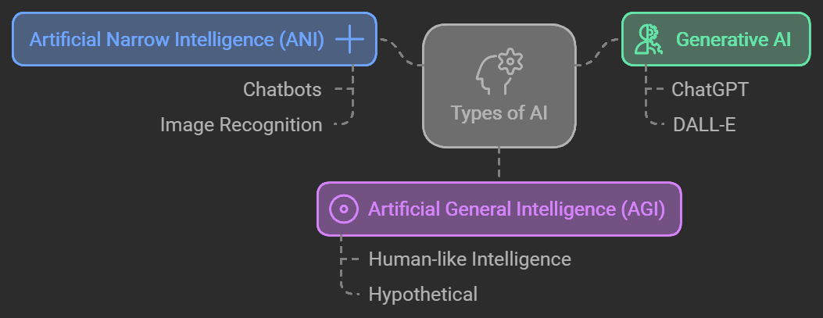
TYPES OF AI
Notes:
ANI is what we see today in most applications like chatbots or recommendation systems.
Generative AI is gaining popularity with tools like ChatGPT, while AGI remains a far-fetched dream.

Slide 3
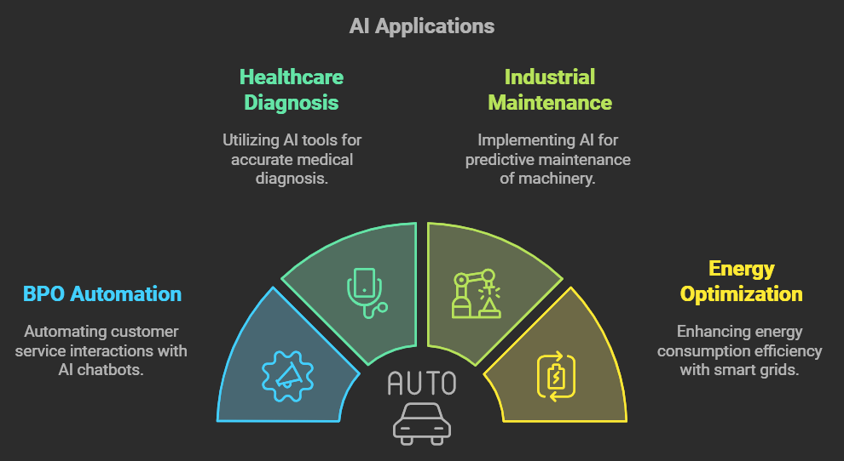
Applications of Artificial Intelligence
Notes:
AI is transforming industries from healthcare to industrial processes by automating repetitive tasks, improving efficiency, and reducing costs.

Slide 4
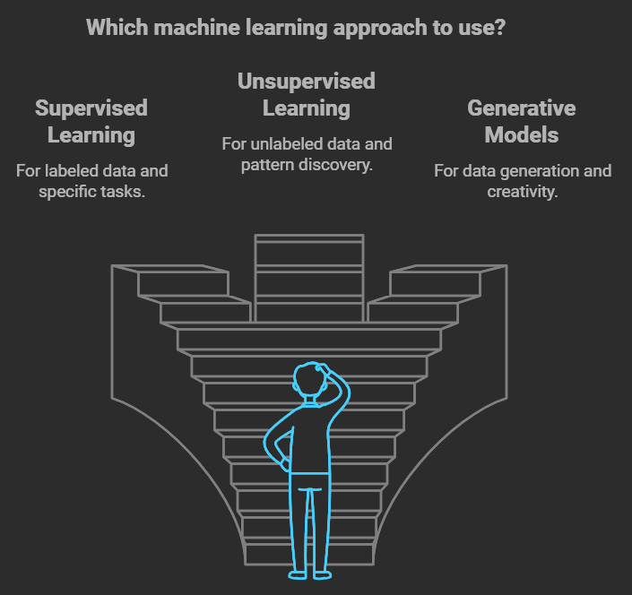
Types of Machine Learning
Notes:
Supervised learning is used in applications like email filtering, while unsupervised learning helps businesses find patterns in customer behavior.
Generative models like GPT are revolutionizing text generation.

Slide 5
Differences
FEATURE | DATA SCIENCE | ARTIFICIAL INTELLIGENCE | MACHINE LEARNING
FOCUS | Extracting insights from data | Creating intelligent systems | Making machines learn from data
APPLICATION | Data analysis, visualization | Automation, decision-making | Predictive models
RELATION | Uses AI/ML for insights | Uses ML for decision-making | A subset of AI
Notes:
- Data science is a broad, interdisciplinary field that focuses on extracting insights from large datasets. It involves data collection, cleaning, analysis, and visualization.
- AI focuses on creating systems that can simulate human intelligence. It aims to build machines capable of performing tasks that typically require human cognition, such as problem-solving, decision-making, and learning.
- ML is a subset of AI that focuses on enabling machines to learn from data without being explicitly programmed. The key idea is that the system improves its performance over time as it processes more data.

Slide 6
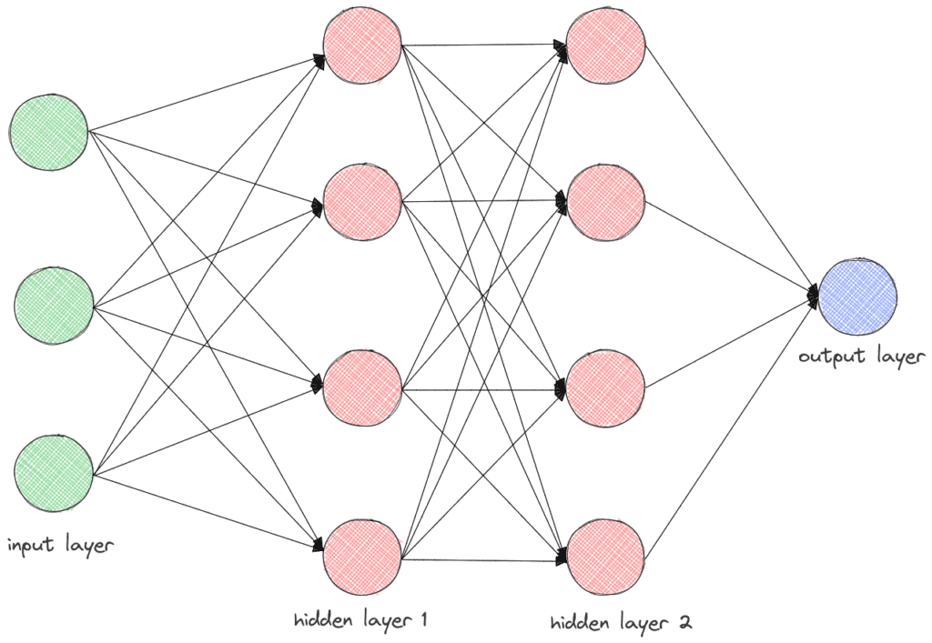
INTRODUCTION TO NEURAL NETWORKS
Neural networks are computational models inspired by the human brain's structure, consisting of interconnected nodes (neurons).
Components:
Input layer - Represents the input data
Hidden layer - Shows one or more hidden layers where computations happen.
Output layer - Displays the final output
Notes:
Neural networks are computational models inspired by the human brain. These networks are composed of layers of interconnected nodes, where each node processes inputs and passes on its output to the next layer.
Components:
Input layer - This is where the raw data enters the network. Each node in this layer represents a feature or variable from the dataset (e.g., pixel values in an image).
Hidden layers - These layers perform computations on the input data using weights and activation functions. The more hidden layers a network has, the deeper it is considered (hence deep learning).
Output layer - This layer produces the final output or prediction. It could be a single value for binary classification or multiple values for multi-class classification.

Slide 7
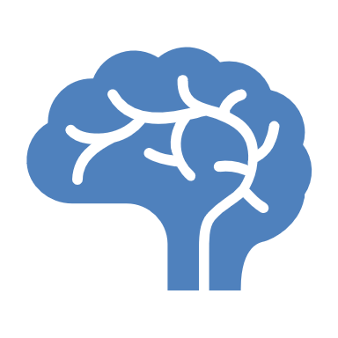
Types of Neural Networks
1 Convolutional neural networks (CNNs) - input images, identify the objects in a picture, and differentiate them from one another.
pattern recognition, image recognition, and object detection
three main layers - convolutional layer, where most of the computation occurs. pooling layer, where the number of parameters in the input is reduced, the fully connected layer classifies the features extracted from the previous layers.
2 Recurrent neural networks (RNNs) - translate language, speech recognition, natural language processing, and image captioning.
smart home technologies – google home, alexa and voice command features on mobile phones - siri
Feedback loops in the structure of RNNs allow information to be stored similarly to how your memory works.
3 Radial basis function (RBF) networks: input layer performs no computations. passes the data directly to the hidden layer. faster learning speed.
time series prediction and function approximation
4 Long short-term memory (LSTM) networks: unique, sort data into short-term and long-term memory cells (data needs to be looped back into the network as data points or entire sequences)
handwriting recognition and video-to-text conversion
5 Multilayer perceptrons (MLPs) : capable of learning the relationship between linear and non-linear data, backpropagation - can reduce error rates.
face recognition and computer vision
6 Generative adversarial networks (GANs): generate new data sets based on training data
art created with AI, deep fake videos
7 Deep belief networks (DBNs): unique, stack individual networks that can use each other's hidden network layers as the input for the next layer, allows for the neural networks to be trained faster.
generate images and motion-capture data. Self driving cars
8 Self-organising maps (SOMs), or Kohonen maps: transform extensive complex data sets into understandable two-dimensional maps where geometric relationships can be visualized.
displaying voting trends for analysis and organizing complex data collected by astronomers so it can be interpreted.

Slide 8
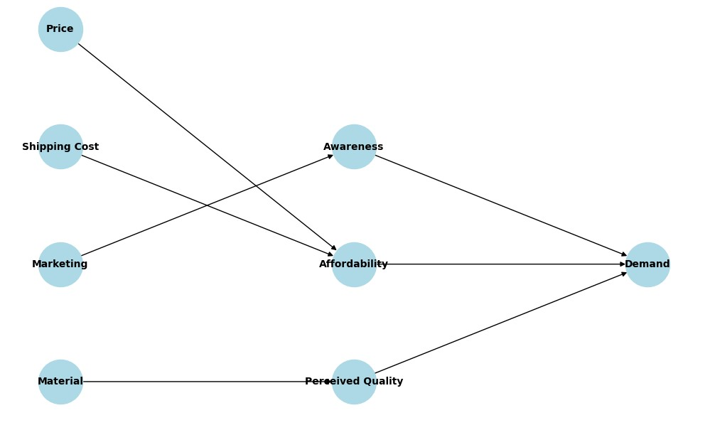

Slide 9
Generative AI - Use of Neural Networks
Generative Adversarial Networks (GANs): LMMs ( Large Muli Modal language models) use GANs for generating realistic images, videos, and audio.
Variational Autoencoders (VAEs): VAEs are used for generating data by learning the underlying distribution of the input data.
They’re effective in generating slightly more controlled and interpretable data, often used in image synthesis and anomaly detection.
Transformers: large language models (LLMs) like GPT, are crucial in generating text and language-based content.
Transformers rely on attention mechanisms rather than recurrence, allowing them to handle longer sequences and generate coherent text, code, or dialogue.
Diffusion Models: popular for generating high-quality images.
“denoise” random noise to create clear images, as seen in tools like DALL-E and Stable Diffusion. They’re known for creating photorealistic and high-resolution images.
Recurrent Neural Networks (RNNs) and Long Short-Term Memory (LSTM) Networks:
Not recently used for Gen AI, RNNs and LSTMs were earlier used in generative text applications, especially where maintaining sequential information was key.
They can still be useful in specific sequence generation tasks.

Slide 10
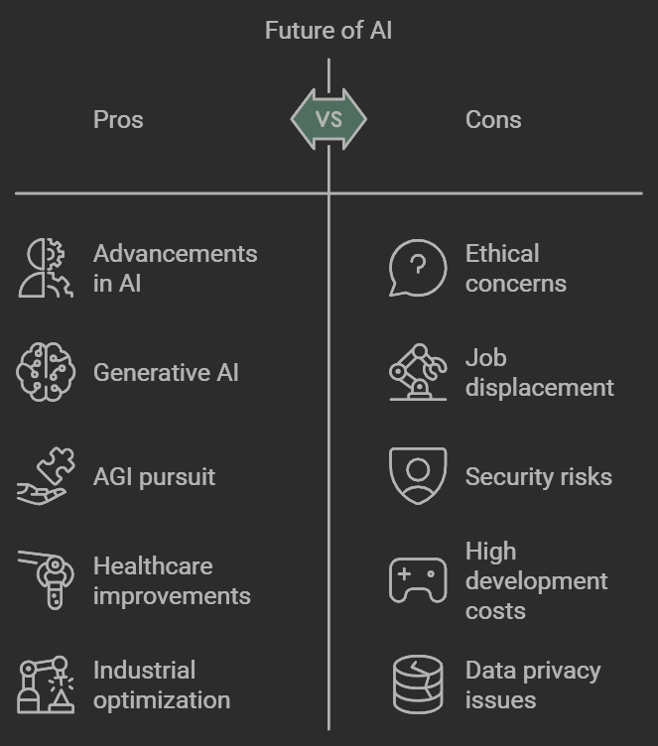
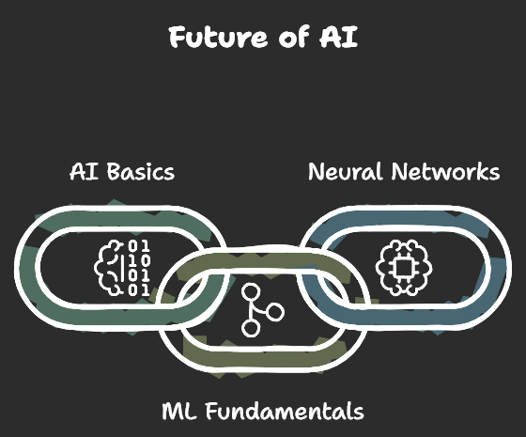
CONCLUSION
Notes:
AI continues to evolve with advancements in areas like Generative AI and the pursuit of Artificial General Intelligence (AGI).
The potential applications are limitless, from improving healthcare diagnostics to optimizing industrial processes.
As we move forward, understanding the basics of AI, ML, and neural networks will be crucial for harnessing the full potential of these technologies in various fields.
The future of AI is exciting, with innovations that will continue to reshape how we live and work.

Slide 11
Thank you very much!

